Slide 1
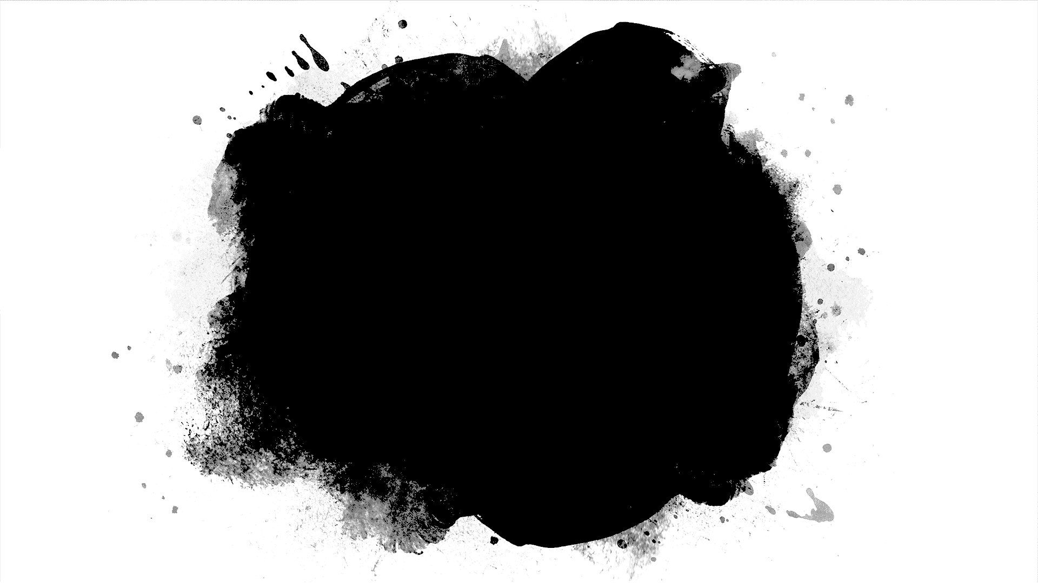
Stations on the Street
Following Christ’s Passion on the Streets of Portland

Slide 2
About Our Time Together
Stations on the Street – A Walking Pilgrimage in Our Community
The Stations of the Cross or the Way of the Cross, also known as the Way of Sorrows or the Via Crucis, refers to a series of images depicting Jesus Christ on the day of his crucifixion and accompanying prayers. The stations grew out of imitations of the Via Dolorosa in Jerusalem which is believed to be the actual path Jesus walked to Mount Calvary. The object of the stations is to help the Christian faithful to make a spiritual pilgrimage through contemplation of the Passion of Christ. It has become one of the most popular devotions and the stations can be found in many Western Christian churches, including Anglican, Lutheran, Methodist, and Roman Catholic (Wikipedia.org).
Today we join in this journey and link our sense of the needs and services of our community with the promise and hope that Jesus’ life offers us in the form of his love and sacrifice. As we walk and reflect on the work we do within our community to help others, let’s give thanks for our collective gifts, love and passion and hold each other in continued hope. As we begin our journey, let us pray: “Assist us mercifully with your help, O Lord, as we contemplate your journey whereby you have given us life and immortality. Help us always to walk in your way. Amen.”
Notes:
QuickStarter has created an outline to help you get started on your presentation. Some slides include information here in the notes to provide additional topics for you to research.

Slide 3
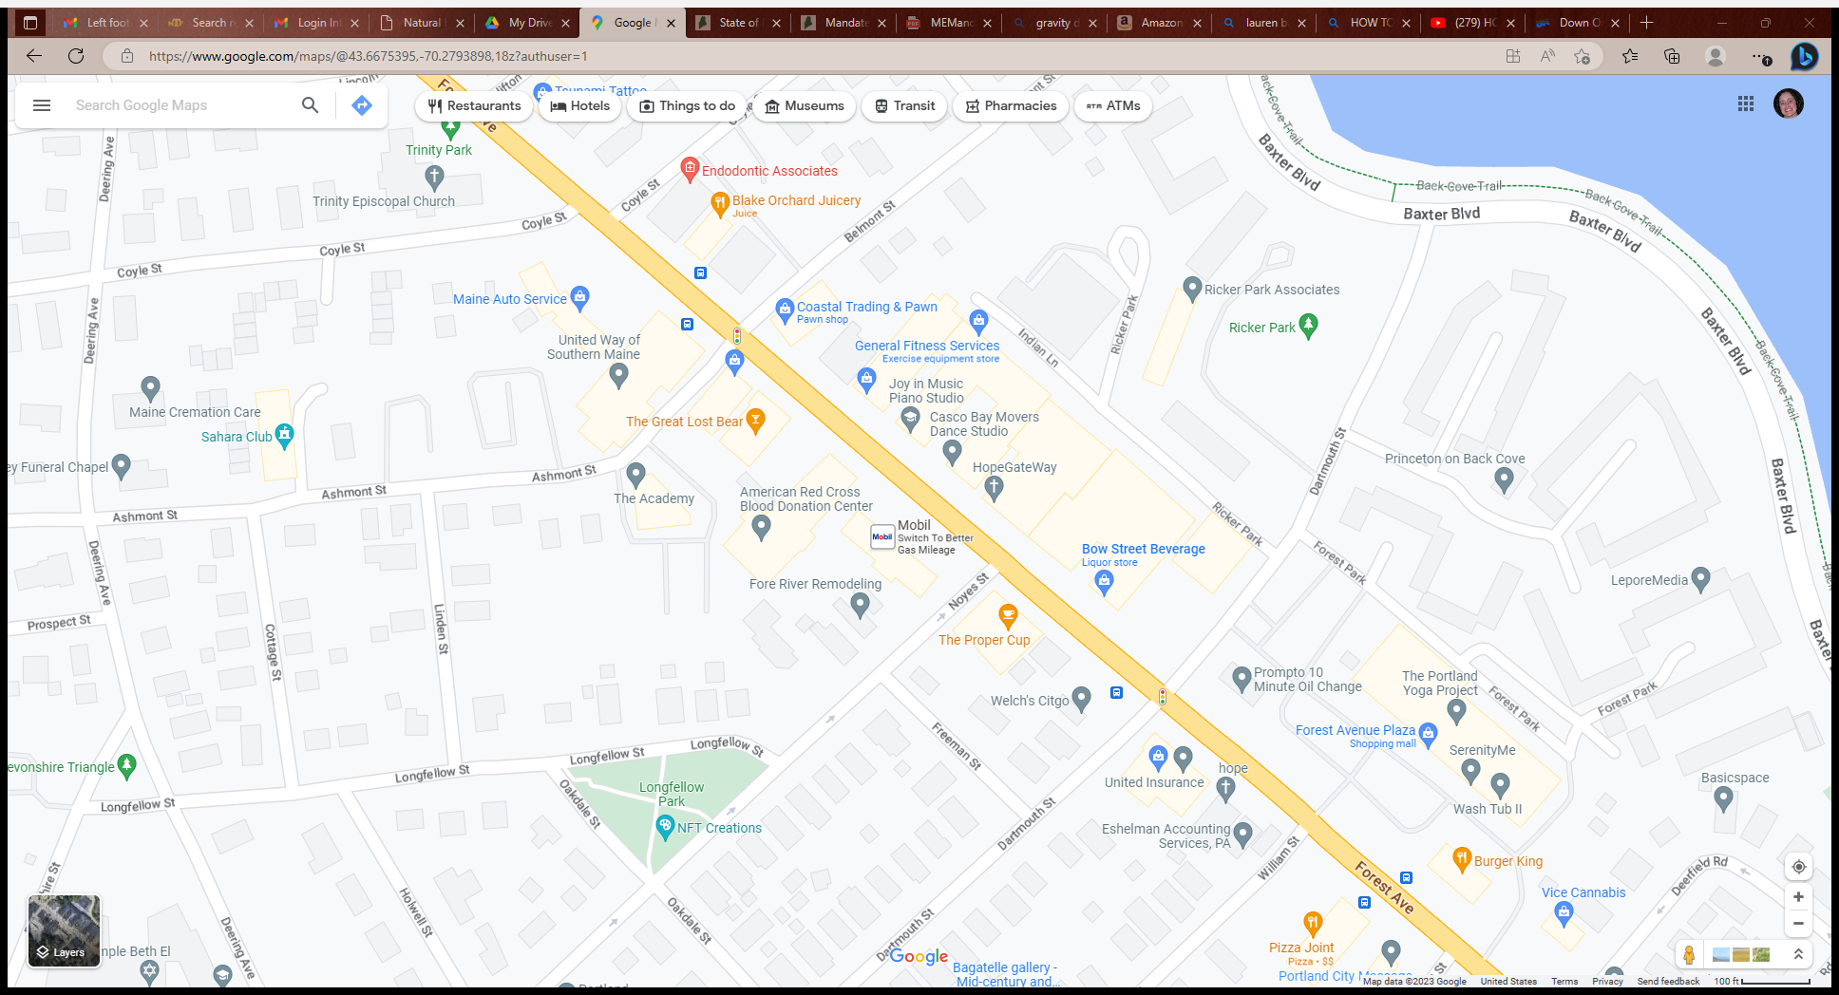

Slide 4
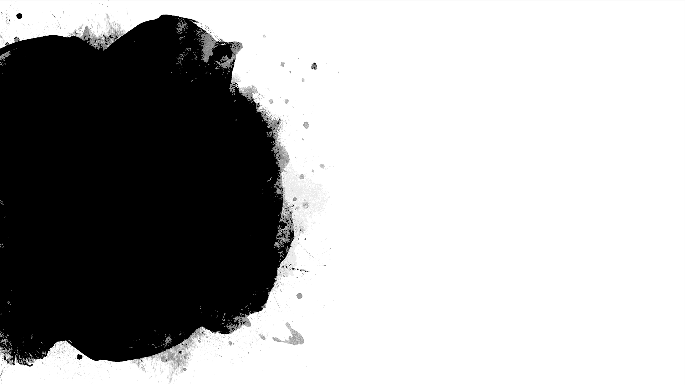
First Station –
Jesus is condemned to death
We gather outside TD Bank where judgement is offered on many by banking institutions concerning credit and worthiness
The Backstory | Jesus was delivered to Pilate for judgement and he was sentenced to death.
A Prayer in our Community | V: God did not spare his own Son: R: But delivered him up for us all. Almighty God, we ask your blessing on all those who pass through judgement in such establishments as our banks and our courts, that they may be dealt with justice and equity. That those in power may discern the truth in the spirt of wisdom and understanding. Amen.
As We Pause, We Pray: | V: Holy God, Holy and Mighty, Holy Immortal One R: Have Mercy Upon Us.

Slide 5
Second Station –
Jesus takes up the cross.
We gather at The Sahara Club-a gathering place for the 12 steps where the cross is taken up
The Backstory | Jesus bears his own cross on the way to Golgotha.
A Prayer in Our Community | V: The Lord has laid on him the iniquity of us all: R: For the transgression of my people was he struck. Like those who seek freedom from addiction Lord, help us bear our burdens and care for the burdens of others by obtaining strength from remembering your perseverance during your guiltless journey to crucifixion. Amen.
As We Pause, We Pray: | V: Holy God, Holy and Mighty, Holy Immortal One R: Have Mercy Upon Us.

Slide 6
Third Station –
Jesus falls for the first time.
We pause on the street where sisters and brothers have fallen.
The Backstory | Jesus was born in human likeness and humbled himself for our salvation.
A Prayer in Our Community | V: Surely he has borne our infirmities R: And carried our sorrows. O God, by reason of the frailty of our nature, we can not always stand upright. Grant us such strength and protection as may support us and carry us through all temptations. Amen.
As We Pause, We Pray: | V: Holy God, Holy and Mighty, Holy Immortal One R: Have Mercy Upon Us.

Slide 7
Fourth Station –
Jesus meets his afflicted Mother.
Center for Grieving Children—a place where grieving children and parents meet and tears are shed
The Backstory | Jesus encounters Mary on the way to Golgotha.
A Prayer in our Community | V: Great as the sea is your grief: A: Who shall heal you? O, Lord, help us stand in love for the children and all families in our community, separated from their parents and those that love them. Hear the cry of all victims of terror and abuse, give hope and solace to those who are bereaved. Grant that we may use such strength as we have to comfort, support, and protect all who grieve or are in need, for your tender mercy’s sake. Amen.
As We Pause, We Pray: | V: Holy God, Holy and Mighty, Holy Immortal One R: Have Mercy Upon Us.

Slide 8
Fifth Station –
The Cross is Laid on Simon of Cyrene
United Way—a place where help is offered to those who are suffering
The Backstory | Simon of Cyrene is given the Cross to carry for Jesus.
A Prayer in our Community | V: May I never boast of anything except the Cross of our Lord Jesus Christ: A: By which the world has been crucified to me, and I to the world. O Lord Christ keep us mindful of your boundless love and when we are called, like Simon, to bear the cross, make us rejoice that we are counted worthy to suffer for your sake and unite what we offer with your perfect sacrifice, through the merits of your eternal redemption. Amen
As We Pause, We Pray: | V: Holy God, Holy and Mighty, Holy Immortal One A:Have Mercy Upon Us.

Slide 9
Sixth Station –
A woman wipes the face of Jesus.
The American Red Cross—a place where mercy is shown to those in need through the gift of blood
The Backstory | Jesus continues his journey, battered, bloodied and weakened - and out of compassion, a woman reaches out to wipe his face.
A Prayer in our Community | Lord teach us to see your face and to find its imprint in all acts of mercy and compassion and in all for who you died. By your Holy Spirit, change us, and conform us to your own image, that through our lives, your light may shine in this world for the glory of your name. Amen.
As We Pause, We Pray: | V: Holy God, Holy and Mighty, Holy Immortal One A: Have Mercy Upon Us.

Slide 10
Seventh Station –
Jesus Falls a Second Time.
We pause on the street where sisters and brothers have fallen.
The Backstory | Continuing his journey, Jesus falls a second time.
A Prayer in our Community | V: But as for me, I am a worm and no man: A: Scorned by all and despised by the people. Lord, we fall again and again: seek us out and recall us to yourself; in your strength, let us stand, and in our paths let us walk secure, for your passion and death are our forgiveness, our salvation and our life. Amen.
As We Pause, We Pray: | V. Holy God, Holy and Mighty, Holy Immortal One. A. Have Mercy Upon Us.

Slide 11
Eighth Station –
Jesus meets the women of Jerusalem.
Gateway Community Services—A place which meets those in need and grief and offers support.
The Backstory | Women were beating their breasts and wailing for him.
A Prayer in our community | V: The elders of the daughters of Zion have thrown dust upon their heads: A: The young girls of Jerusalem bowed their heads to the ground. Lord Jesus, help us to pray and care for all those impacted by domestic violence. Give hope and comfort to those whose selfworth, shelter and livelihood have been impacted by the cruel and misguided hands of another. Restore peace and a foundation of love to those who enter here for help and support. Amen.
As We Pause, We Pray: | V: Holy God, Holy and Mighty, Holy Immortal One A: Have Mercy Upon Us.

Slide 12
Ninth Station –
Jesus Falls a Third Time.
We pause on the street where sisters and brothers have fallen
The Backstory | Jesus continues his walk and falls for a third time.
A Prayer in our Community | V: He was led like a lamb to the slaughter: A: And like a sheep that before its shearers is silent, so he did not open his mouth. O God, by the passion of your Son you made an instrument of shameful death to be for us the means of life: Grant us so to glory in the Cross of Christ, that we may gladly suffer shame and loss for the sake of your Son our Savior Jesus Christ. Amen.
As We Pause, We Pray: | V: Holy God, Holy and Mighty, Holy Immortal One A: Have Mercy Upon Us.

Slide 13
Tenth Station –
Jesus is Stripped of His Garments.
Coastal Trading and Pawn Shop-a place where many are stripped of their possessions due to life circumstances
The Backstory | Jesus is stripped and his clothes are taken by those casting lots for them.
A Prayer in our Community | V: They gave me gall to eat: A: And when I was thirsty, they gave me vinegar to drink. Lord Jesus, you stood before all the world, with no one beside you and nothing to protect you, exposed to ridicule and grievously wounded: make us strong in the face of suffering, strip from us all false pride and for your sake, who suffered such cruelty, make us abhor all injustice and violence. Amen.
As We Pause, We Pray: | V: Holy God, Holy and Mighty, Holy Immortal One A: Have Mercy Upon Us.

Slide 14
Eleventh Station –
Jesus is nailed to the cross.
We walk several feet and pause.
The Backstory | Jesus is nailed to the cross with two criminals and promises the one who acknowledges him that he will be with him in heaven that day.
A Prayer in our Community | V: They pierce my hands and my feet: A: And have numbered all my bones. Father, even in our pain and our own need, let us be aware of the great need of those around us and strive to meet that need by the urging of your Holy Spirit within our hearts. Let us be generous, feeding those around us out of our own hunger to be like you. Amen.
As We Pause, We Pray: | V: Holy God, Holy and Mighty, Holy Immortal One A: Have Mercy Upon Us.

Slide 15
Twelfth Station –
Jesus Dies on the Cross.
We pause on the street. Those who are so moved are invited to kneel
The Backstory | Jesus cries with a loud voice, “Father into your hands I commend my spirt” and he handed over his spirit.
A Prayer in our community | V: Christ for us became obedient to death: A: Even death on a cross. By your death, O Lord, we are given life; grant that we may receive this great gift with awe and humility, and let our lives be no longer our own, but yours, now and to the day of eternity. Amen
As We Pause, We Pray: | V: Holy God, Holy and Mighty, Holy Immortal One. A: Have Mercy Upon Us.

Slide 16
Thirteenth Station -
The body of Jesus is placed in the arms of his mother.
A mother is invited to hold the processional cross
The Backstory | Greif befalls Mary as she holds her Son, and the hope of the world, in her arms.
A Prayer in our Community | V: Zion spread forth her hands: A: And there is none to comfort her. For the sake of your Blessed Mother, who was stricken with grief: be comfort and strength, Gracious Lord, to all who are bereaved; be light and hope to the dying and, by your own merits and through the prayers of all the saints bring us all through life’s sorrows to the unending joy of your heavenly kingdom. Amen
As We Pause, We Pray: | V: Holy God, Holy and Mighty, Holy Immortal One A: Have Mercy Upon Us.

Slide 17
Fourteenth Station –
Jesus is laid in the tomb.
Levey Funeral Chapel—a Jewish funeral home
The Backstory | Joseph of Arimathea offers his tomb for Jesus’ body. He attends to the body, wraps it in a shroud and rolls a large stone in front of the tomb where it is laid.
A Prayer at Our Crossroad | V: You will not abandon me to the grave: A: Nor let your holy One see corruption. Lord Christ, as your body was laid in a tomb, you descended into hell, to break its ancient doors and free those held in its grasp; Give to us, and all the faithful departed release from sin and the torment of separation from you, for you are the mighty to save, now and forever. Amen.
As We Pause, We Pray: | V: Holy God, Holy and Mighty, Holy Immortal One A: Have Mercy Upon Us.

Slide 18
Final Prayers Before the Altar–
We Gather in the Nave of Trinity Episcopal Church
The Backstory | We enter the Nave of Trinity Church and give thanks to God for the work in our community of so many organizations and individuals who bring the Stations of the Cross to life. We pray for healing, hope, and resurrection in the midst of the suffering of the world.
A Prayer for our Community | We continue to pray for our city, Father, and ask that you help enable us to eliminate poverty, prejudice, and oppression, and that you would grant the necessities of life to all. Amen
 | We say the Our Father
As We Retire | May the glorious passion of our Lord Jesus Christ bring us to the joys of paradise. Amen

Slide 19

Appendix: Further References
Stations of the Cross by Forward Movement
www.forwardmovement.org

